Slide 1

CodeKataBattle Project RASD and DD
Ferlin Francesco – Giacomo Orsenigo – Federico Saccani

Slide 2
Requirements Analysis and Specification Document RASD
Notes:
Start person talking (Orsenigo)

Slide 3
Goals of the System (1/2)
G1: Educators can organize tournaments of programming exercises aimed at improving their students’ skills.
G2: Educators can organize battles in a tournament they have created.
G3: Educators can aid their colleagues in creating battles.
G4: Educator can decide how to score a battle they have created.
G5: Students can be notified about new tournaments.
G6: Students can subscribe to tournaments.
G7: Students can be notified about new battles in tournaments they are subscribed to.
G8: Students can form teams to take part in a battle.
G9: Teams of students can join a battle.
G10: Students and educators can monitor the progress of all students in battles and tournaments.
G11: Educators can manage students’ gamification badges.
G12: Students can receive badges depending on the rules they have fulfilled.
G13: Students and educators can see badges collected by a student.
Notes:
Skip immediatly to the next slide to see the subdivision

Slide 4
Goals of the System (2/2)
G1: Educators can organize tournaments of programming exercises aimed at improving their students’ skills.
G2: Educators can organize battles in a tournament they have created.
G3: Educators can aid their colleagues in creating battles.
G4: Educator can decide how to score a battle they have created.
G5: Students can be notified about new tournaments.
G6: Students can subscribe to tournaments.
G7: Students can be notified about new battles in tournaments they are subscribed to.
G8: Students can form teams to take part in a battle.
G9: Teams of students can join a battle.
G10: Students and educators can monitor the progress of all students in battles and tournaments.
G11: Educators can manage students’ gamification badges.
G12: Students can receive badges depending on the rules they have fulfilled.
G13: Students and educators can see badges collected by a student.
Educators managing
Tournaments + Battles
Students actions
Tournaments + Battles
+ Teams
Monitoring progress
Scores + Badges

Slide 5
World and Machine Phenomena
A user wants to log in to the platform
A user logs in
An educator wants to create a tournament
An educator creates a tournament
An educator grants permissions for a tournament
to another educator
The system pulls the latest sources,
analyses them, and runs the tests
A student wants to take part in a tournament
A student subscribes to a tournament
The system notifies students
about a new tournament
A student wants to see the ranking in a battle
An educator creates a battle as part of a tournament he has permissions for
The system notifies students
subscribed to a tournament about a
new battle in said tournament
The system calculates the
battle score of the team.
A student wants to invite
other students in a tournament
A student invites another student to take part in a battle with him
The system sends the link to a GitHub repository
containing the code for a battle to all students who
are members of subscribed teams
An educator wants to see the ranking in a battle
A student accepts the invitation of another student to take part in a
battle with him
A student joins a battle on their own
World
Shared
Machine
The registration deadline of a battle expires
A student pushes a new commit in their
repository main branch
The system notifies students
taking part in a battle that the
final battle rank is available
The platform updates the
personal tournament score of
each student
A student forks the GitHub repository
A student or an educator visualize the current rank of a battle
An educator manually evaluates the submission of a
team for a battle he has created
A student sets up the automated workflow
The system notifies students taking part in a
tournament that the final tournament
rank is available
An educator closes the consolidation stage
A student writes code
An educator closes a tournament
Any subscribed user visualizes the
list of current tournaments
The submission deadline expires
and the consolidation stage starts
Any subscribed user visualizes
the ranking of a tournament
An educator defines a badge
A student achieves a badge
Any subscribed user visualizes the
badges achieved by a student
Any subscribed user visualizes the badges achieved by a student
Notes:
Say the most important phenomena very quickly After this slide, change person speaking (Saccani now talking)

Slide 6
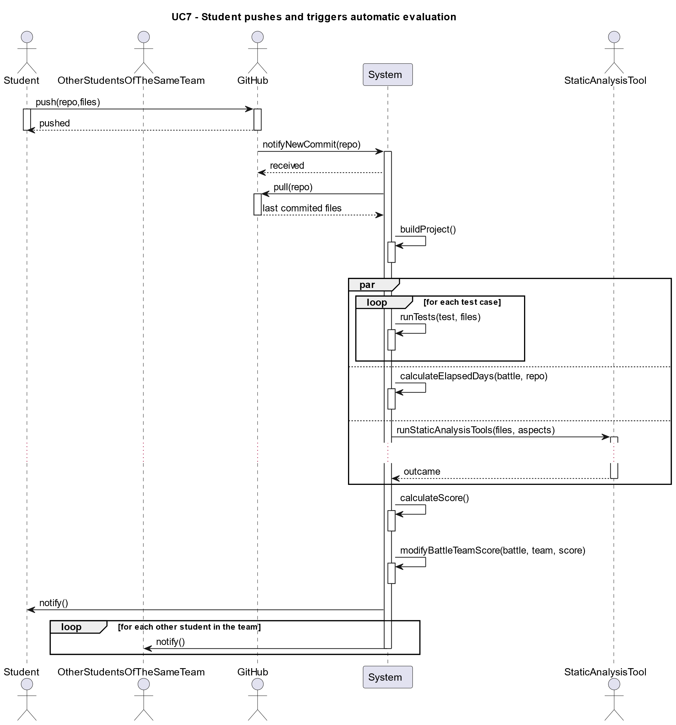
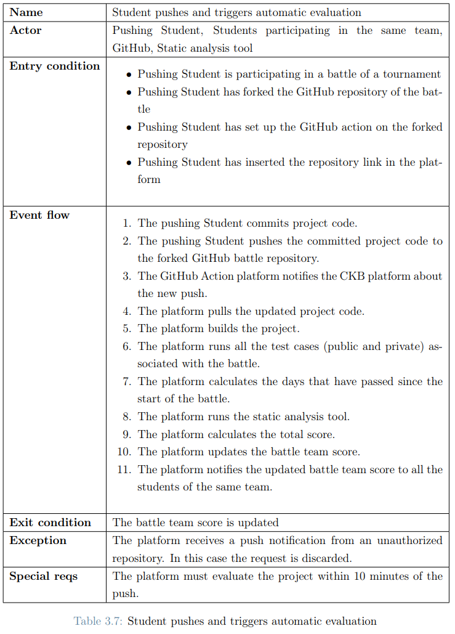
A Meaningful Use Case
UC7: Student pushes and triggers automatic evaluation
Notes:
No more animations after purple animation

Slide 7
Some of the most important Requirements (1/2)
The total number of requirements we identified is 21 (from R1 to R21). Some of the most important ones are the following:
R2: The system shall allow the educator to create a tournament
Also with R2.1, R2.2, R2.3 and R2.4 (allow managing the tournament)
R3: The system shall allow students to subscribe to a tournament
R4: The system shall allow the educator to create a battle within the context of a specific tournament.
Also with R4.1, R4.2, R4.3, R4.4, R4.5, R4.6, R4.7, R4.8, R4.9 and R.10 (allow managing the battle)
R5: The system shall allow students to join a battle, respecting the minimum
and maximum number of students per group.
Also with R5.1 and R5.2 (allow students to send and receive invitations)
R8: The system shall expose an API that can by called by the GitHub Action platform
R9: On each push, the system shall calculate and update the battle score of the team Also with R9.1, R9.2, R9.3 and R9.4 (properties in order to calculate the score)
R20: The system shall allow the educator who create a tournament, to create badges within
the context of the tournament.
Also with R20.1, R20.2, R20.3 and R20.4 (allow managing the badge)

Slide 8
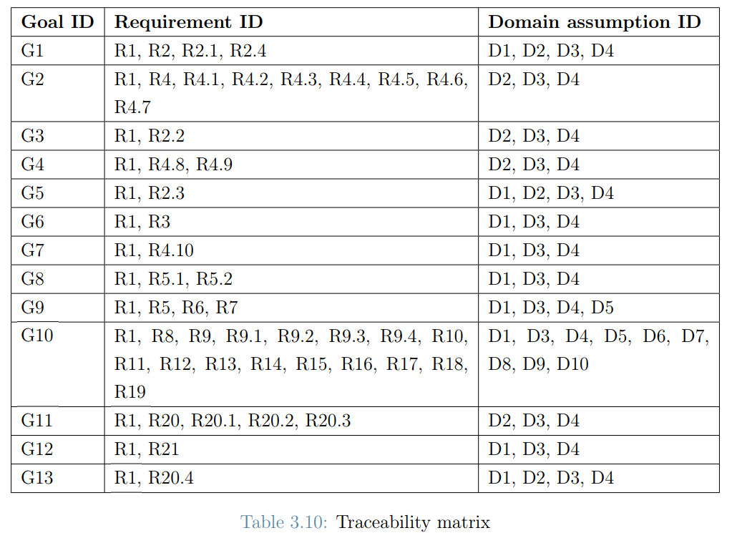
Some of the most important Requirements (2/2)
Taceability matrix:
R1
Allow log in with SSO
Notes:
First animation: red circles wrt previus important requirements Second animation: obvious R1 requirments to allow students to log in

Slide 9
Assumptions
D1: Students are enrolled in the school.
D2: Educators teach in the school.
D3: The school has an existing authentication system that can be used by the CKB platform.
D4: Students and educators have an account on the existing authentication system.
D5: Students correctly fork the GitHub repository of the code kata battle.
D6: Students correctly set up an automated workflow through GitHub Actions.
D7: The grade assigned manually by the teachers reflects the work done.
D8: The GitHub Action platform is working properly.
D9: Test cases and build automation scripts uploaded by educators are correct.
D10: The static analysis tool is working.
Accedemic Environment
Login based on University SSO (Single Sign On)
Correct behavior
By Students and Educators
Reliable External Dependecies
Notes:
After this slide change person speaking (Ferlin now talking)

Slide 10
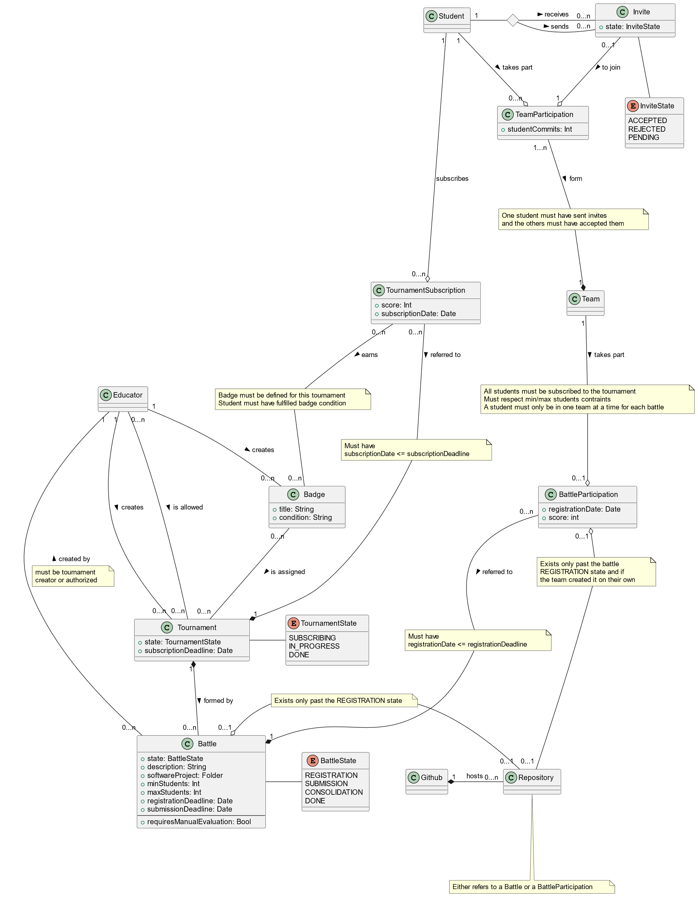
Alloy Model (1/3)
We translated the following Class Diagram into Alloy
Notes:
Now we can also show the Class Diagram and say that we translated all the elements in the Alloy Code

Slide 11
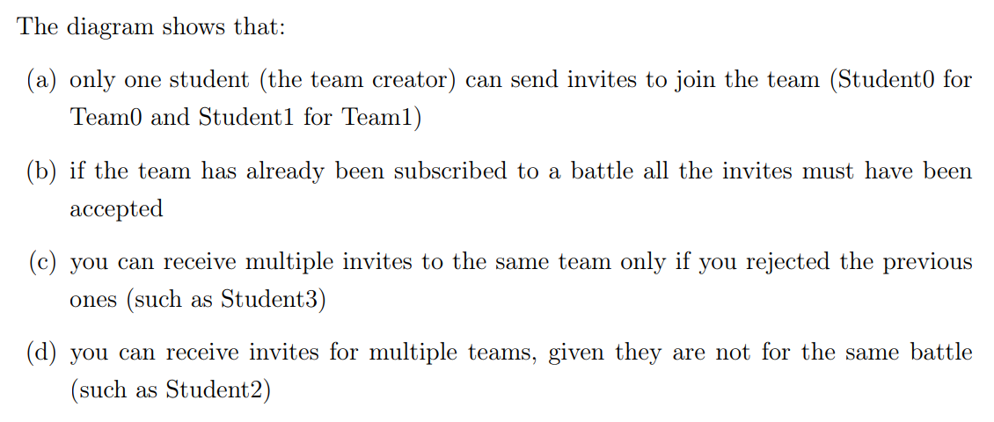
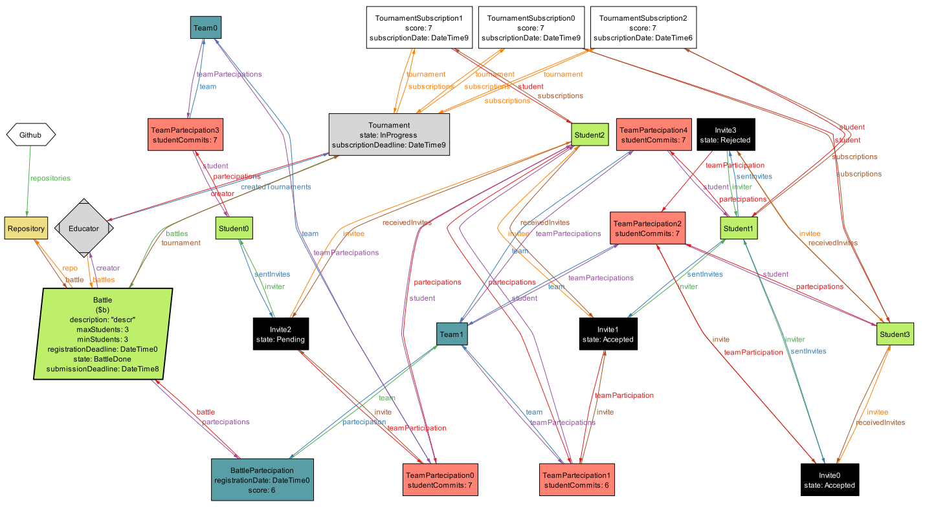
Alloy Model (2/3)
Notes:
This show some important properties like the invitation part (discussed more in detail with code in the next slide)

Slide 12
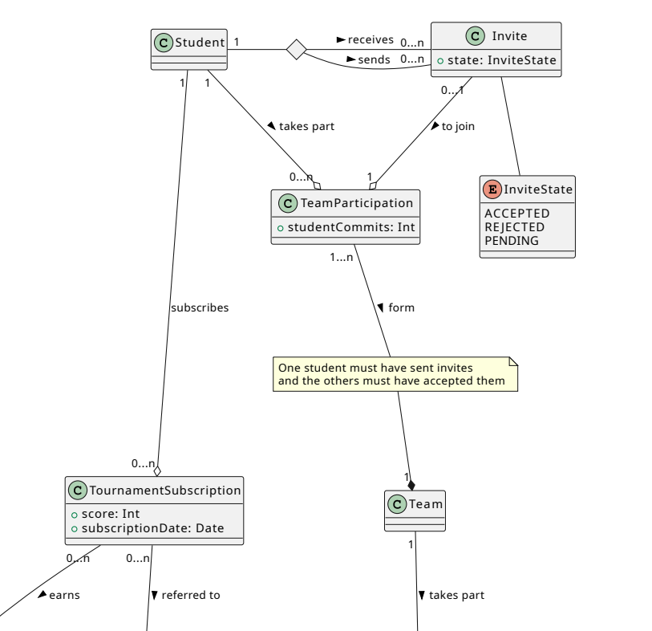
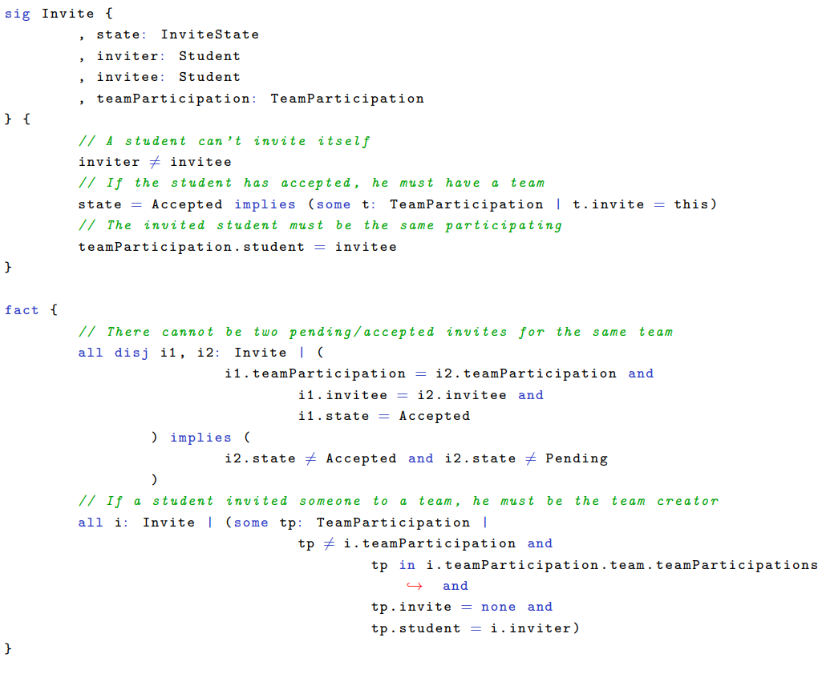
Alloy Model (3/3)
Zoom in the Class Diagram ‘Invite’ Section
Some extract of the Alloy Code regarding the ‘Invite’ property
Notes:
After this slide RASD part completed -> We will start talking about DD Change person speaking (Orsenigo Now Speaking)

Slide 13
Design Document DD

